Slide 1
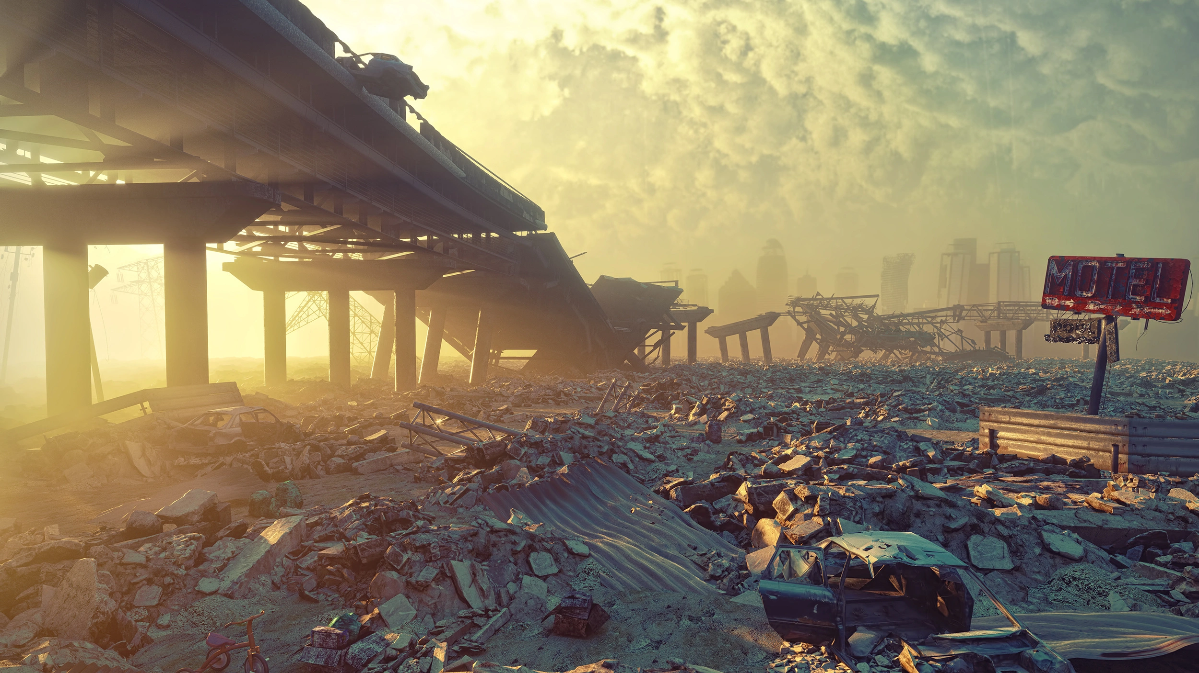
Human extinction starting from China
Negar Abelehkoub

Slide 2
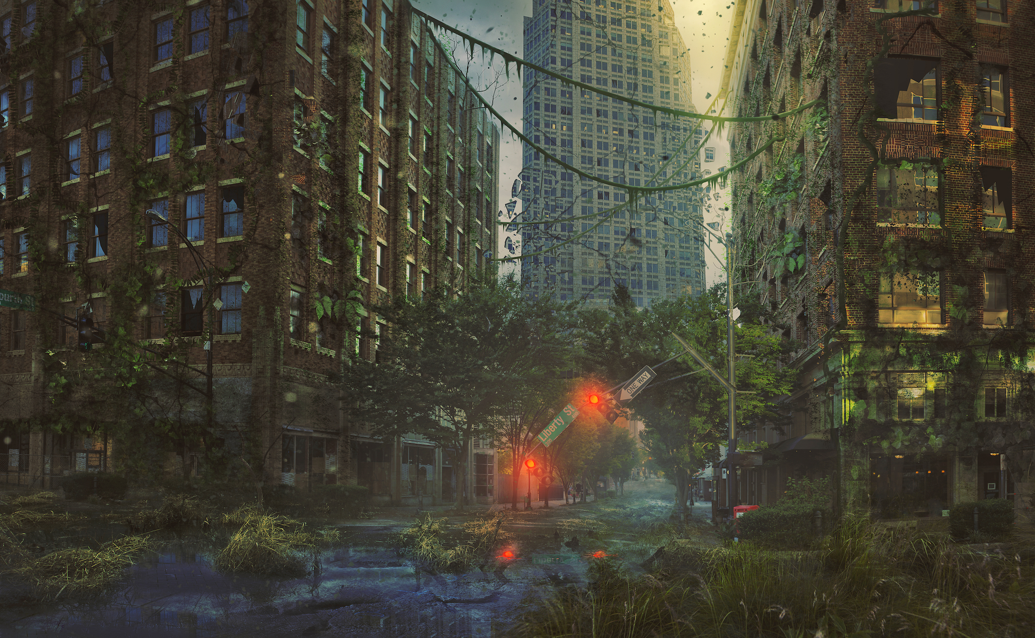
Many people say that human end would be a nuclear expulsion or a big tsunami but the greatest danger for our spice is ourself. The waste we create and the jungles we put on fire, but I think the most dangerous thing for us is our selves. Or we better say the problem is that our population is growing nonstop and without ending.

Slide 3
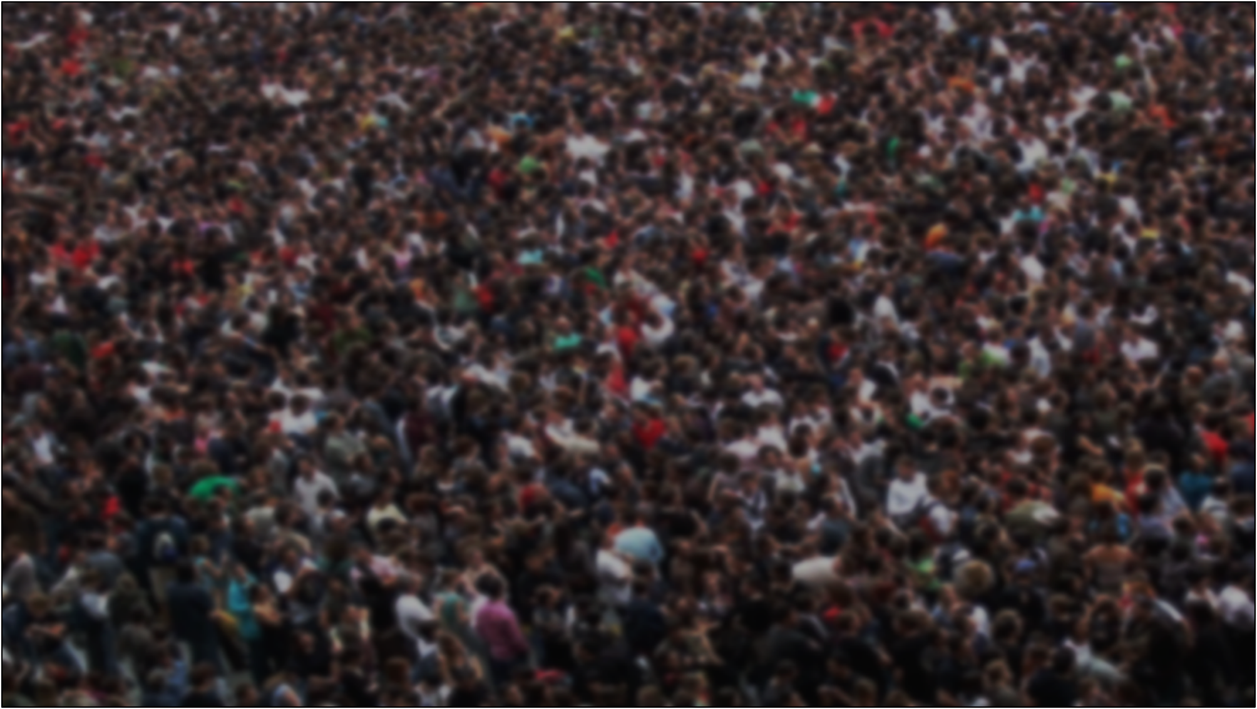
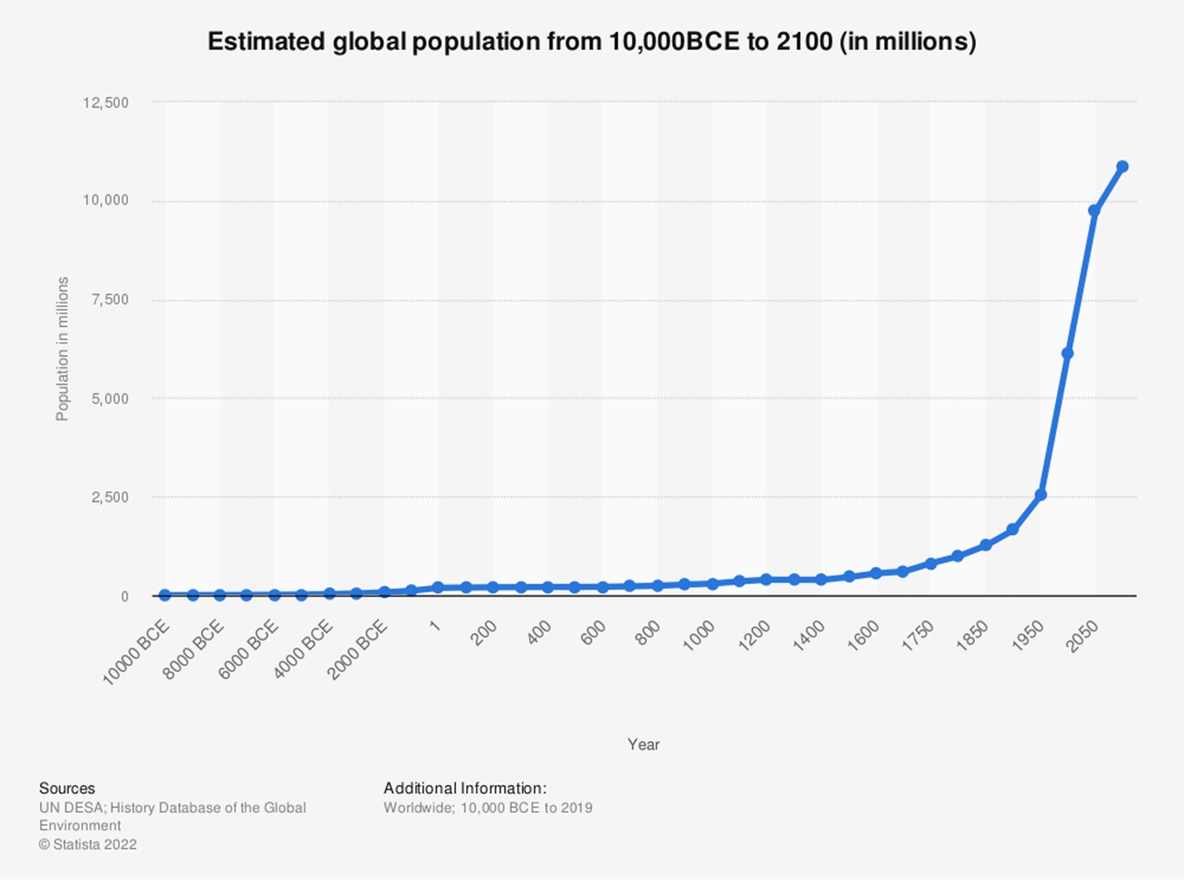
Humans are reproducing more than they should have done in last tow thousand years. Since the beginning of the Common Era two thousand years ago human population had grown weirdly. In about Christ’s birth we were only 200 million but now after only two thousand years they are 7.98 Billion. but the wired part is that it only took us 12 years to add 6 billion and 13 years to add 7 billion.

Slide 4
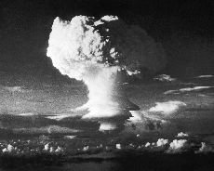
Some people say that rate of dying by a nuclear expulsion or hunger or even dieses are more than over population. Well, they are right. according to statistic :
Civil wars 21% nuclear war 5% Molecular nanotechnology weapons 26%
As you can see over populating is not even considered as a risk but what will cause the civil wars , nuclear wars or climate change? The humans create them to answer their needs. 7.98 Billion humans need food and a place to sleep and an electricity to charge their phones and …

Slide 5
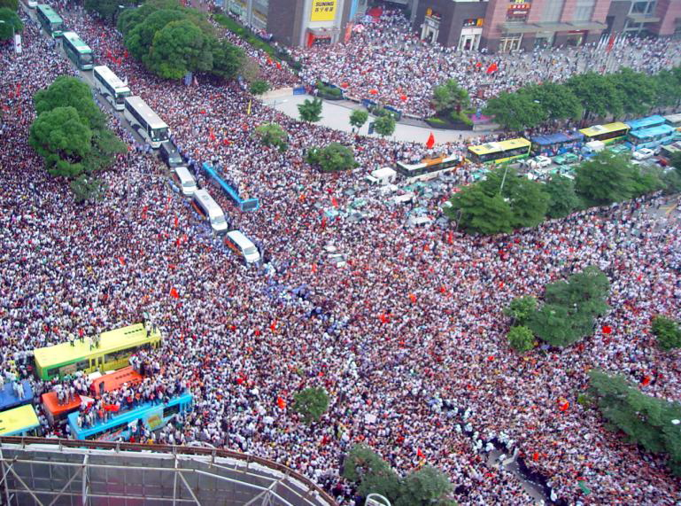
CHINA

Slide 6
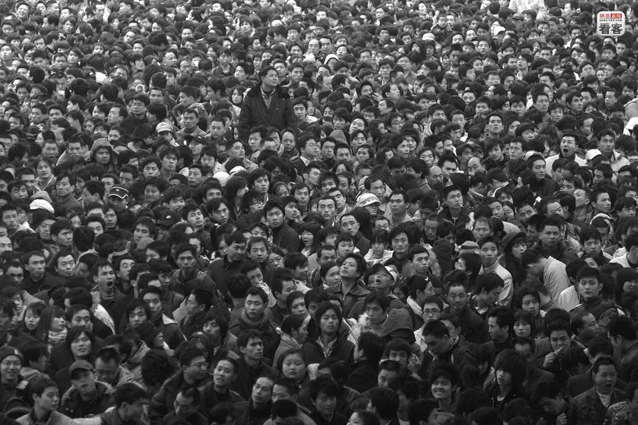
Although China don’t have a land as big as Russia or Canada, but the number of people living there is more than two countries. Overpopulation in China is one of the most serious problems that the hole world is facing because it brings exhaustion of natural resources and also environmental at pollution. And all these thing will cause a flood as big as it can drown a city or hunger.

Slide 7
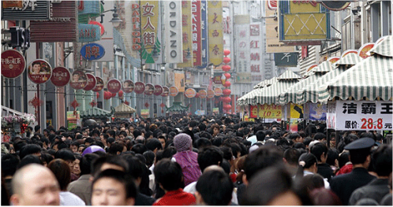
statistics show that China had 4.09% unemployed people in 2014. If the unemployment rate rise , we will see that the country is becoming dangerous, and the reasons is crime. According to Xin Hua News (2015), more than 168,000 narcotic-crime suspect was arrested by police in 2014. There had about 70 tones of drugs, including 25.9 tones of methamphetamine and 9.3 tones of heroin.

Slide 8
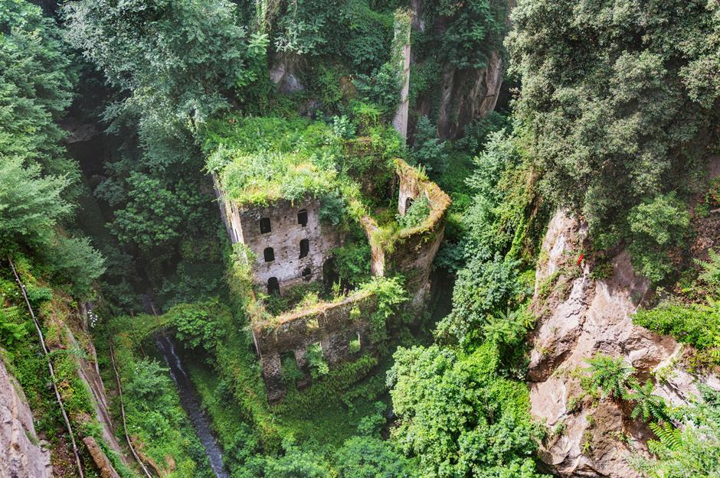
Solutions
China has a one child police which I think is one of the good things to control population.
But there is always other ways too but as usual they are harder. We should turn into green energy and by that, I mean destroying all factures that use fossil fuels and leaving our cars and start believing that we are not aliens and this earth is our plant

Slide 9
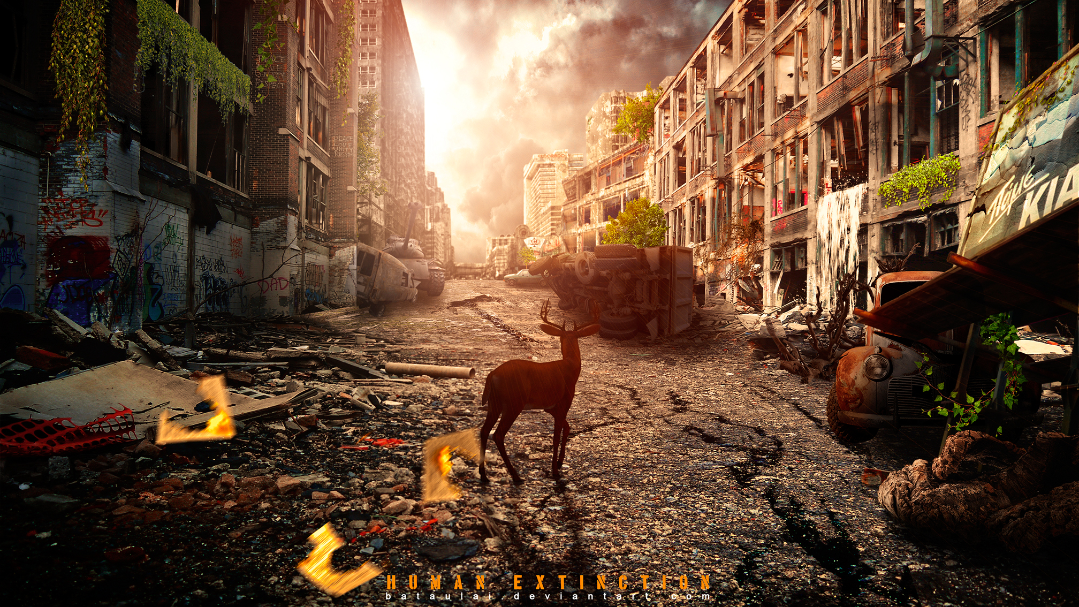
Thanks for your attention

